Slide 1

Fleet Street Heritage CIC
Revised psresentation following meeting with Planning Dept
20 June 2024

Slide 2

The Wall under the Sundial
The wall at present has 3 plaques at eye level
The Newspaper Industry
The sundial
The Freedom of the Press
The 3 plaques are shown here or at https://fleetstreetheritagesundial.uk/plaques.html
Proposal 1 moves these plaques to a central position above the large panel
Proposals 2 and 3 leave the plaques and have four small panels in the four on the map
Proposal 4 has a large central TfL-type map with 4 columns spmilar to proposal 3 grouped 2 each side of it with white squares indicating the position of each on the map

Slide 3
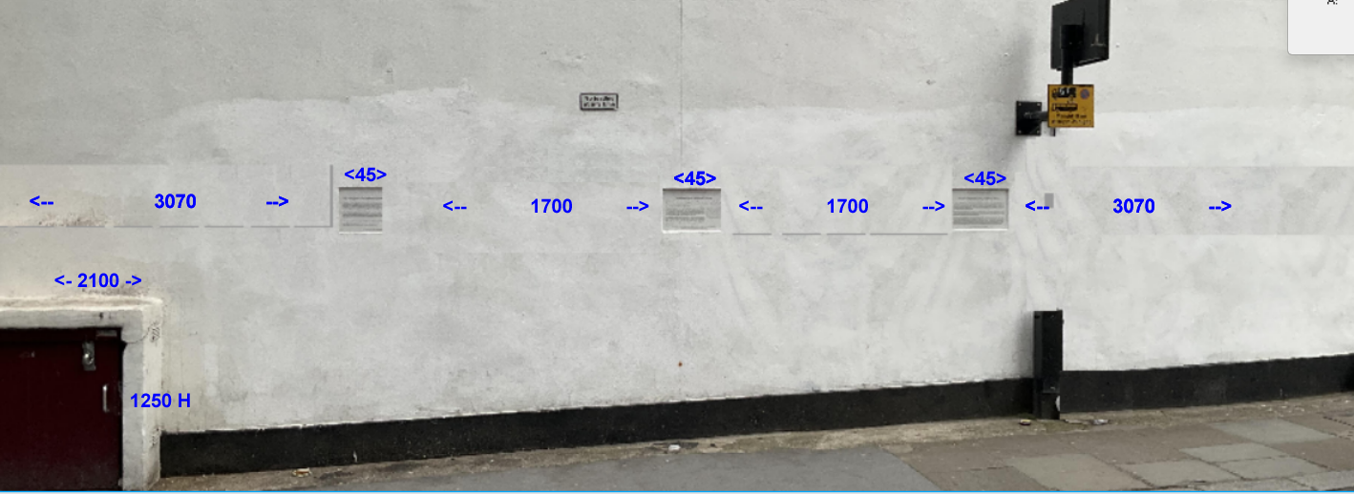

The Wall
The wall has the Fleet Street Heritage Sundial, which is 10 m .square, at the top, and 3 small plaques at eye level at the foot.

Slide 4
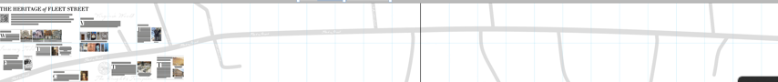
Proposal 1
Four large panels (left one only shown above and on next slide) each consisting of 2 rows of 7 portrait 300 x 450 tiles, so the panel measures 900h x 2100w)
The four panels could be joined up to give a continuous map of Fleet Street measuring 900 x 8400. In this case, the three existing plaques could be put in a row along the top)
Or the 3 pl aques could be put in a vertical column, measuring 900h x 450
(see next page for detail of the left hand panel)

Slide 5
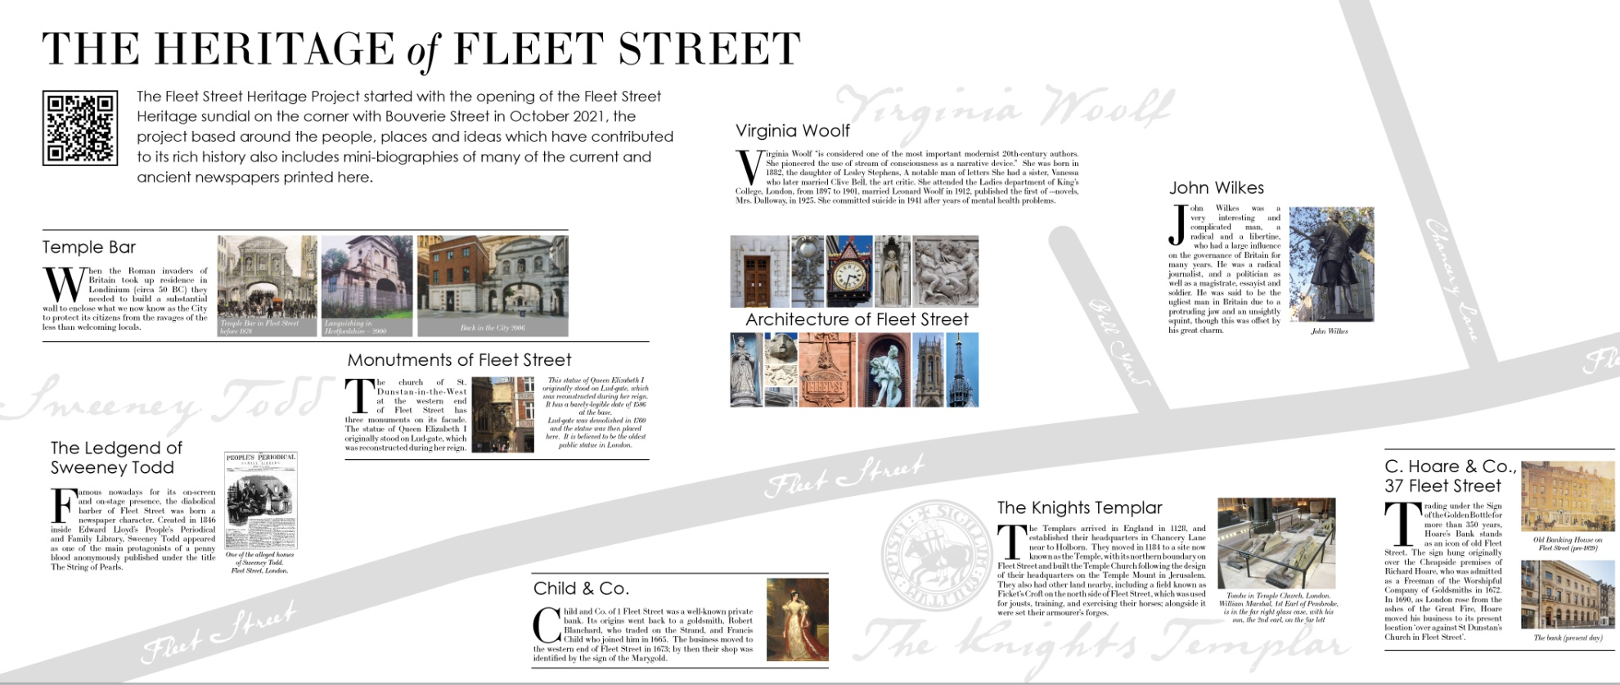
Proposal 1 (left section)

Slide 6
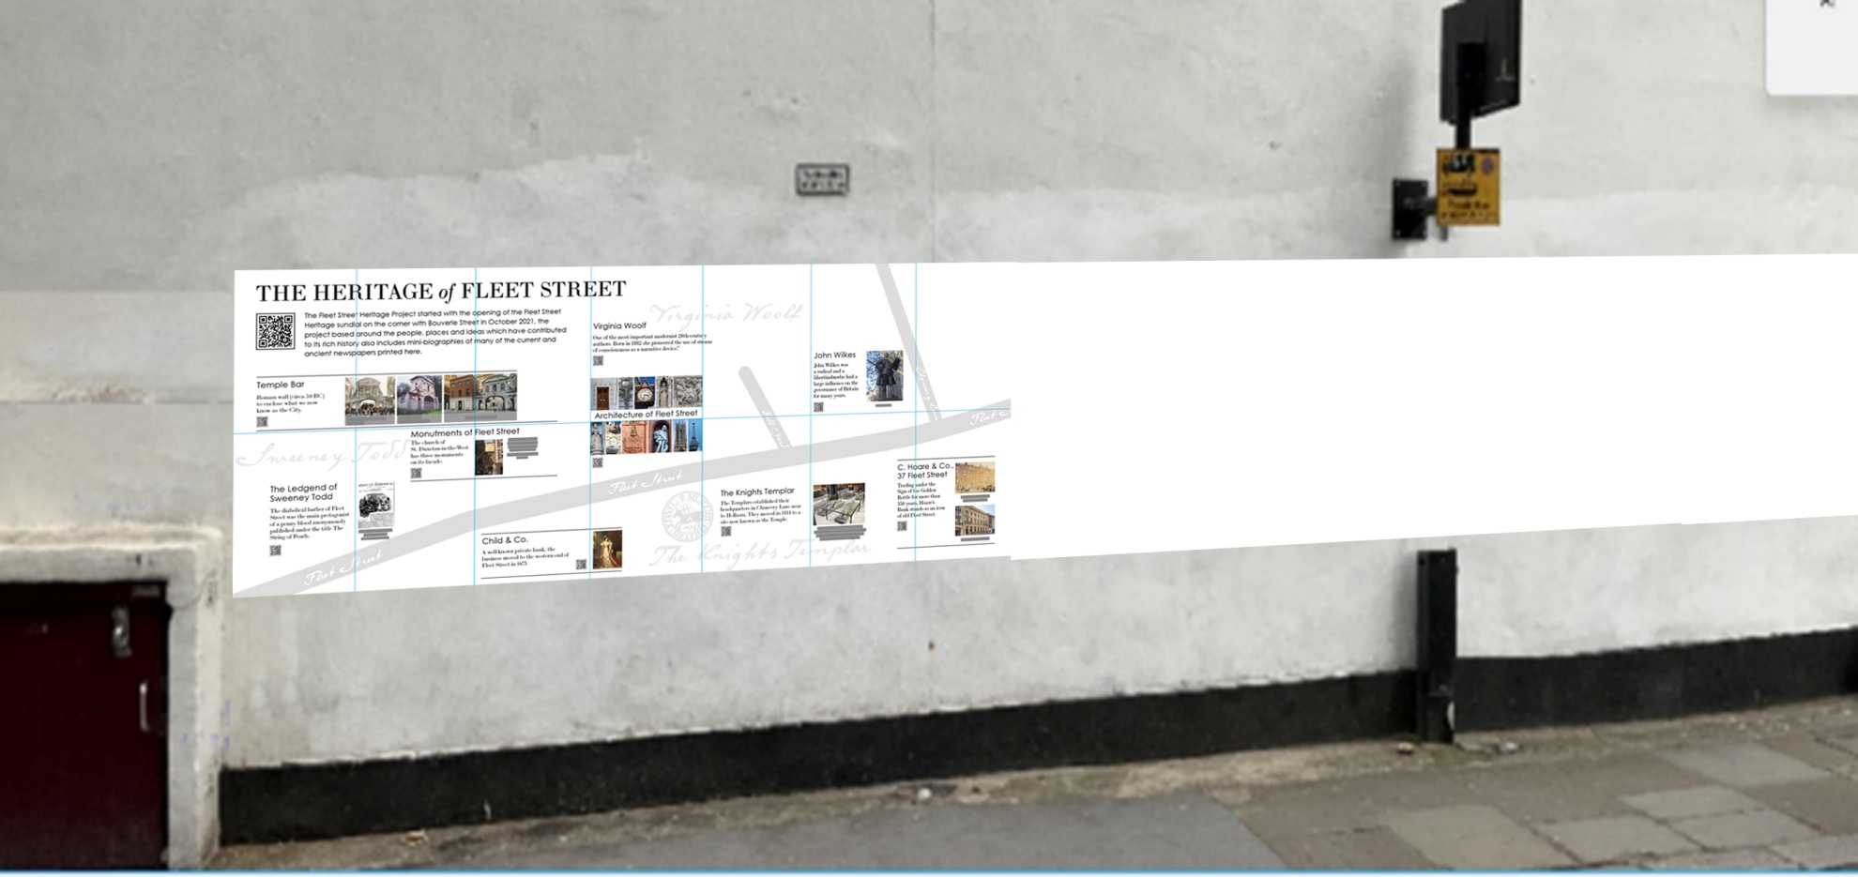
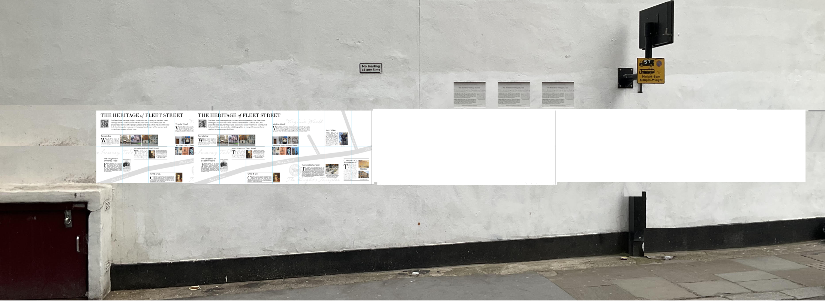
Artist’s impression of Proposal 1

Slide 7
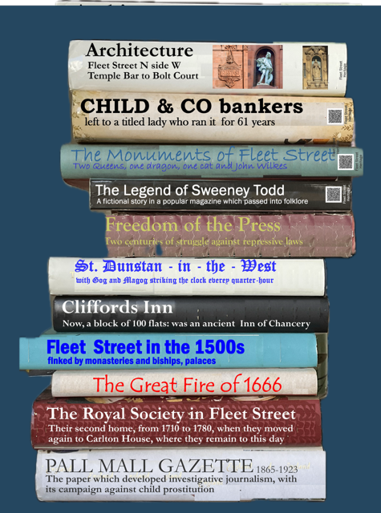
Proposal 2
4 panels measuring 900 w x 600 h(2 landscape tiles ea)
All titles will have a QR
code linking directly
To the web page on that
subject (as shown for
The top 4 titles)

Slide 8

Alternative Proposal 2
With Heritage title

Slide 9
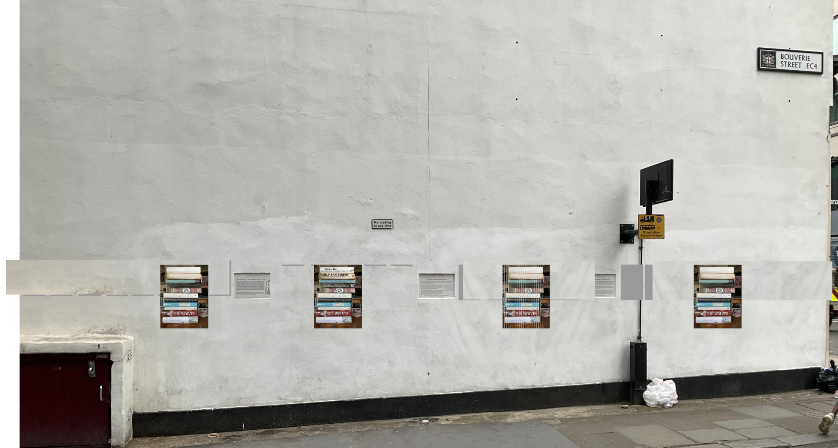
Artist’s impression of Proposal 2
Proposal 3 would be similar

Slide 10
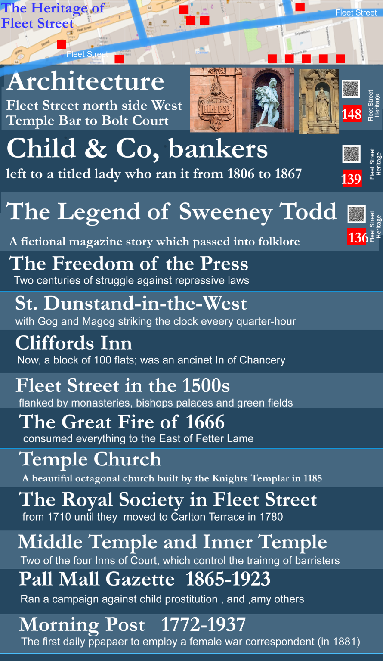
Proposal 3
4 panels measuring
1500 w x 600 h
(2 landscape tiles ea.)
All items have a QR code linking directly to the web page and a red square with a number,
The red squares on the map will have identical
Numbers (not shown)
The indicative map
Shown will be replaced by a TfL
Kerbide map in the
Style of the next page

Slide 11
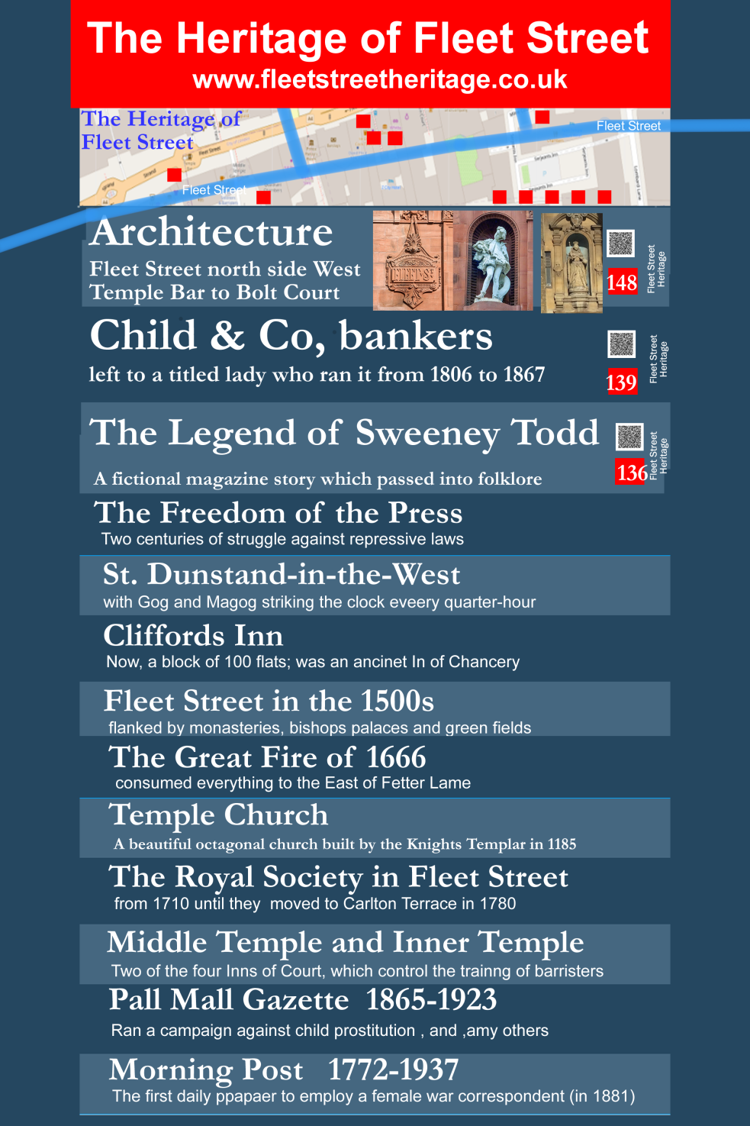
Alternative Proposal 3
With Heritage title

Slide 12
Proposal 4.
Two columns of page headings on each side of a TfL-style map. The hteadings numbered 1A onwards for the first column, then 2A and so on. The headings would be arranged so that the numbers on the map went from top to bottom; the left hand side of the map shows an examaple
The next page shows an artists impression,
Yhe following page shows a TfL map similar to the kerbside maps well-known around the City. We would commission a special map which would have the blue roads with their names in white, but would not have the yellow points of interest or Or indication of bus stops, stations, toilets, etc

Slide 13
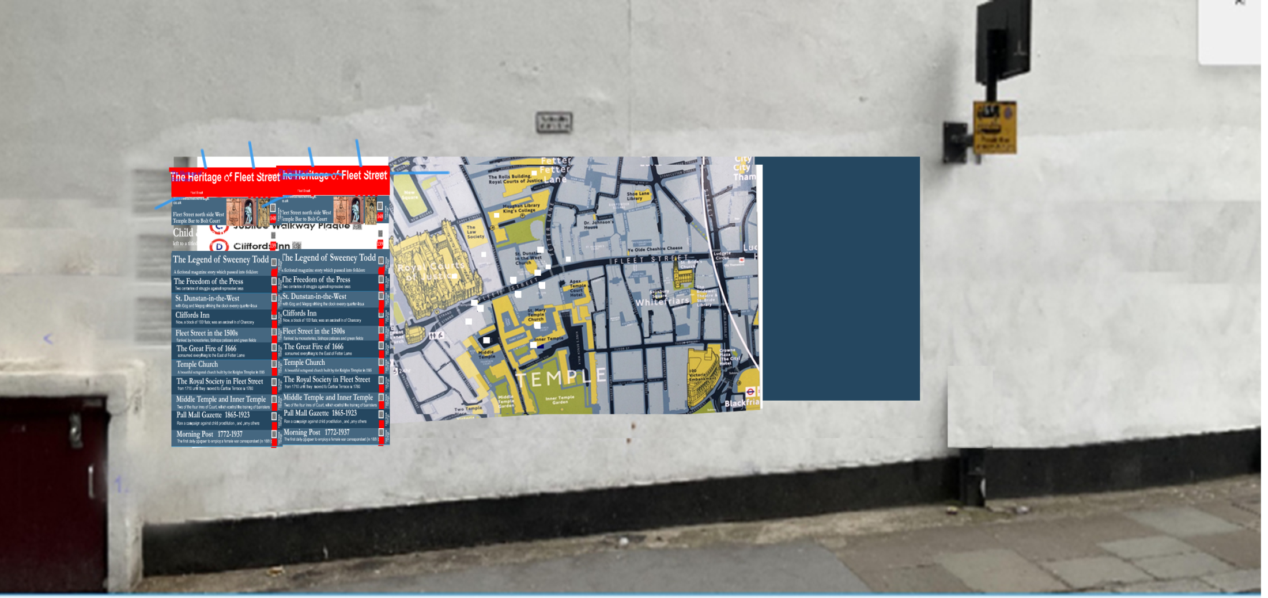
Artists impression of Proposal 4
Artists impression of Proposal 4

Slide 14
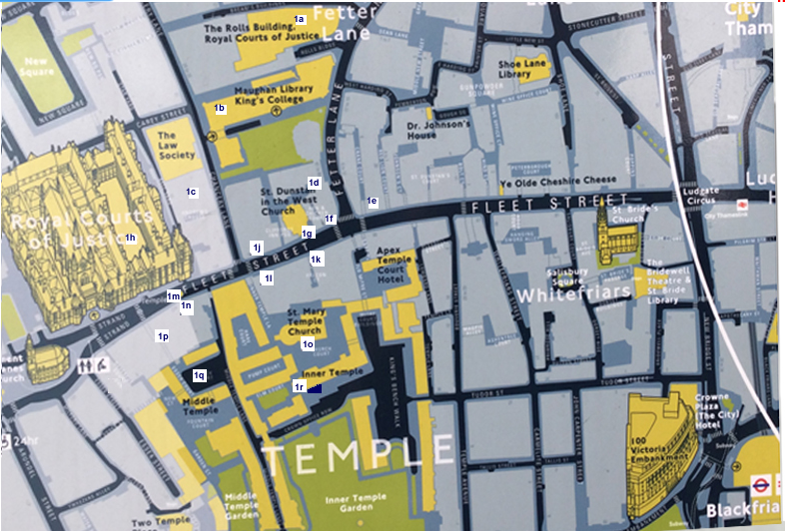

Slide 15
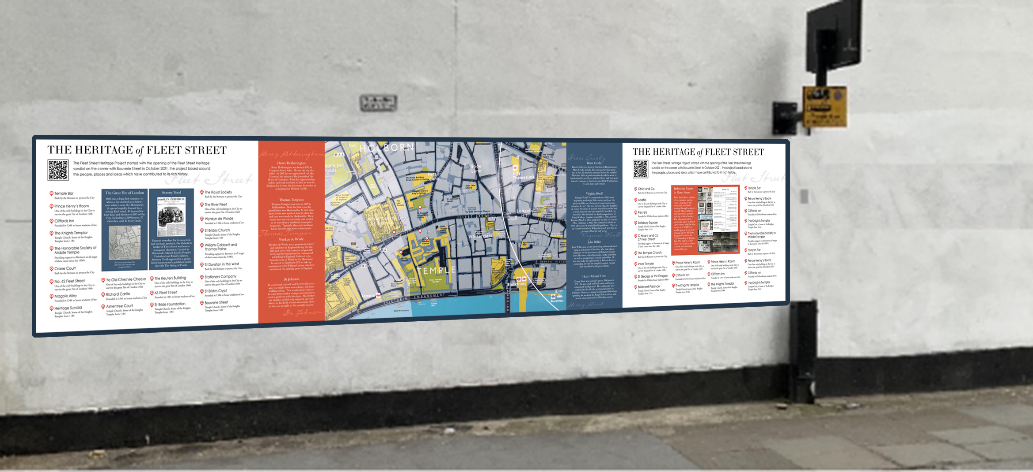
Artist’s impression of a variation on Proposal 4

Slide 16
Ease of navigation & audio
Each web page has a QR link to the homepage
Homepage has links to all 80 web pages
Each web pages will have an audio link
For proposals 2,3 and 4, QR codes link to the relevant web page
For proposals 3 and 4, the numbered red boxes ion the map link to
the similar boxes in the title panels
For proposal 4, it will be particularly easy to link the map to the
title panels

